Slide 1
Multi Energy Systems (MES) Investigating Hidden Flexibilities Provided by Power-to-X Converters Considering Grid Support Strategies
MSc: Bekir Caner Yagci (4857089)
PhD: Digvijay Gusain
Supervisor: Asst. Prof. Milos Cvetkovic
Delft University of Technology
Faculty of Electrical Engineering,
Mathematics, and Computer Science

Slide 2
Content
Research Problem
Flexibility
Research Questions
Methodology
Modelling
Cases & Initial Results
Future Plans

Slide 3
Research Problem
With increasing share of renewable energy, power balance became more challenging for grid operators
Due to approximations made in model formulations, flexibilities provided by MES components to network can be concealed in the simulation results (hidden flexibility)
Inaccurate flexibility analysis of P2X may lead to increased transmission losses, higher operational cost or misinterpretation of MES capacity.
Existing hierarchical management of MES models not considers operational cost of production. This results with unnecessary trading of electricity and increse in operational cost.

Slide 4
Flexibility
”In this project, flexibility defined as the amount of consumed energy that is provided by changing the consumed power state of P2X by controlling the output product flow rates.”
” Changing the storage tank set values, when the flexibility is “on”, will accelerate the electrical power consumption of P2G and P2H to nominal values or to a specific power state coming from CEMS.”

Slide 5
Research Questions
What options exist for minimizing curtailment of renewables in MES?
Which options are available in Port of Rotterdam?
Which option provides the highest amount of flexibility?
Which combination of MES is the most cost-effective one?
How much the model detail impact the amount of flexibility provided?
What should be the detail of a model for desired MES analysis?
What is the amount of flexibility provided by detail of electrolyser model?
What is the amount of flexibility provided by detail of heat pump model?
How can different energy domains can be combined and optimized for flexibility?
What should be the control architecture of MES?
How should be the optimization algorithm in order to reduce operational cost during flexibility provision?
What are the dependencies between flexible load pairs?

Slide 6
Methodology – Tools
OpenModelica
For fast simulation of complex dynamics from different energy domains
Pandapower
To initialize OM models
Energysim (Co-simulation)
To implement hierarchical control, reduce computational burden and couple different energy domains.

Slide 7
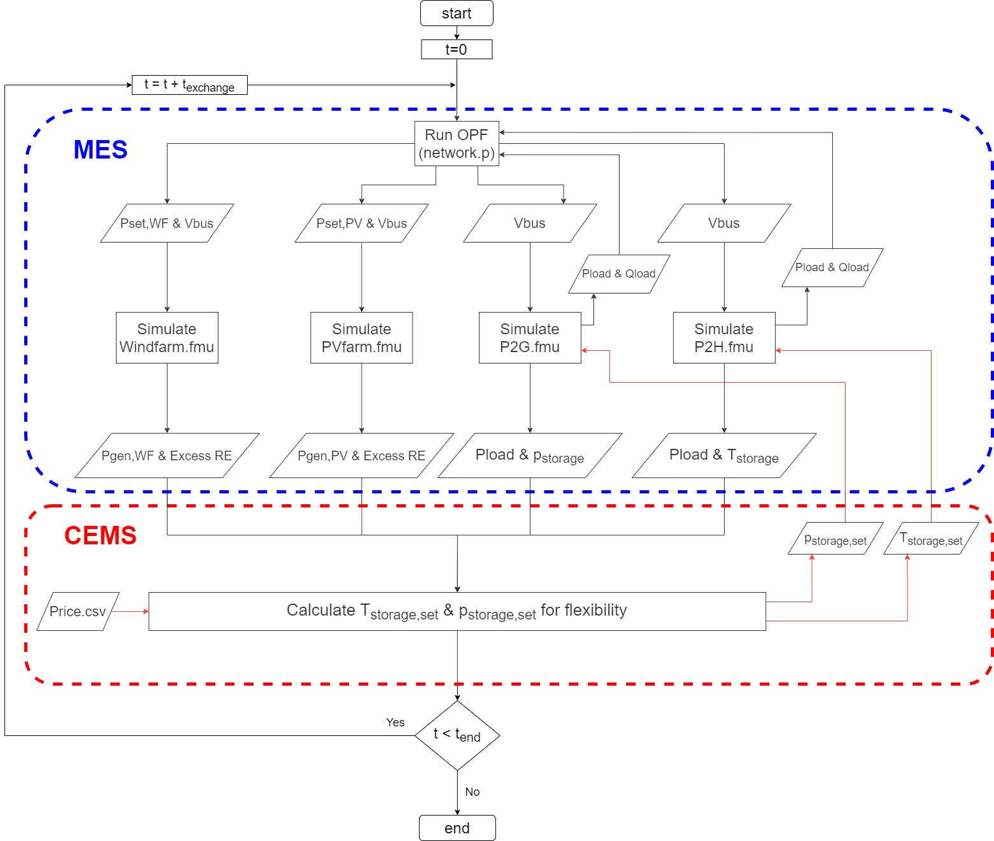
Methodology – Hierarchical Control

Slide 8
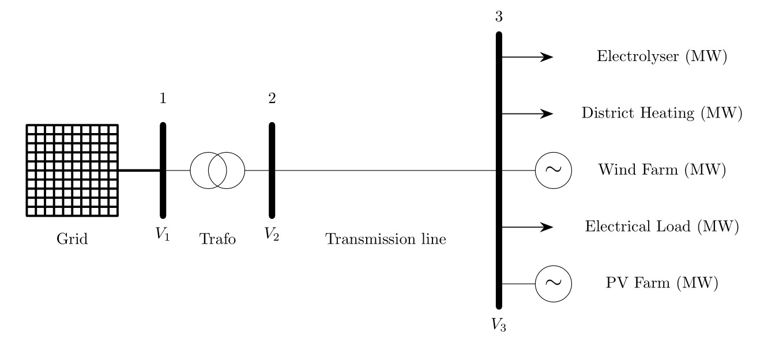
Methodology – Maasvlakte Energy Park
Notes:
The figure includes the
processes that allow for the storage and transport of electrical energy (Gray blocks)

Slide 9
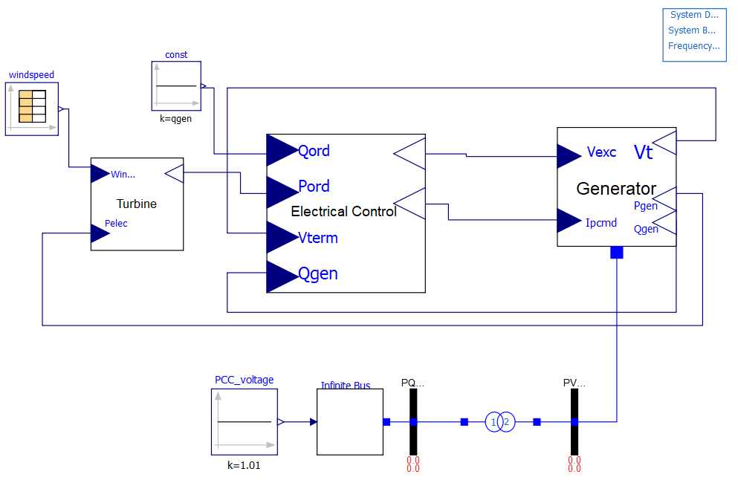
Modelling – Wind Turbine Generator
Turbine, converts mechanical power from wind into AC power order
Control, commands the active and reactive power generated
Generator, provides interface between the controller and network

Slide 10
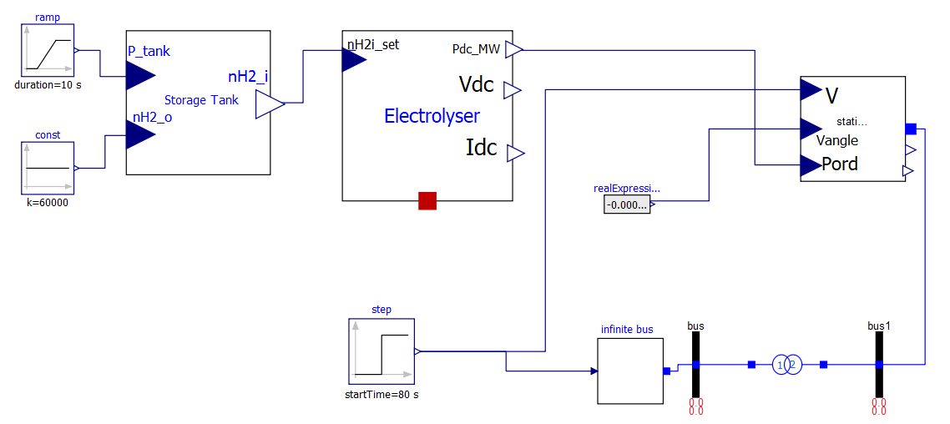
Modelling – P2G
Storage, calculates input hydrogen molar flow rate from demand flow rate and pressure
Electrolyser, calculates DC power consumed
StaticGenerator, provides interface and controls Qload

Slide 11
Cases
First case:
To determine the holding duration for providing flexibility, plot the “active power demand/generation at bus3 vs. time” without any flexibility. Plot the same figure in all cases in order to investigate the effect of flexibility on active power balance.
Second case:
To investigate the hidden flexibilities, compare the amount of flexibility provided at nominal power set value for different Electrolyser models for same holding time decided in case 1. Do the same for heat pump model.
Third case:
To investigate the effect of hierarchical control on flexibility, add community energy management system to the combined (P2H & P2G) system and measure the amount of flexibility for P2G & P2H.

Slide 12
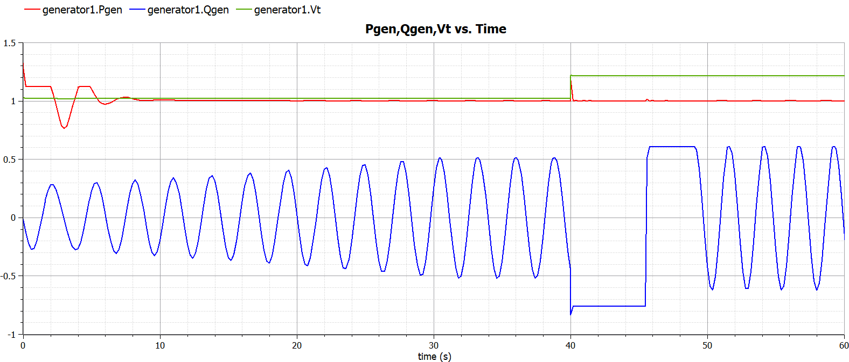
Initial Results - WTG

Slide 13
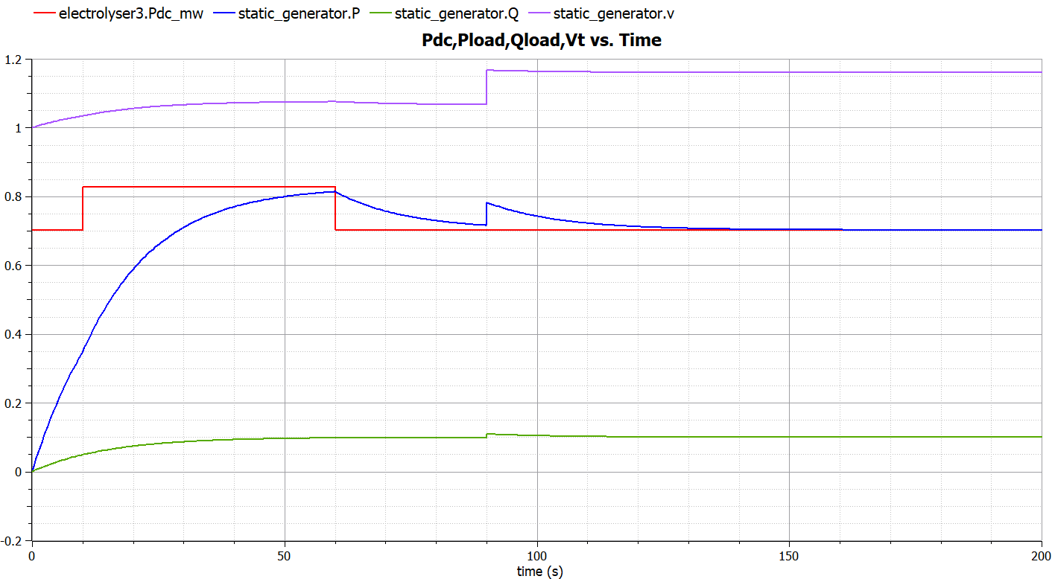
Initial Results – P2G

Slide 14
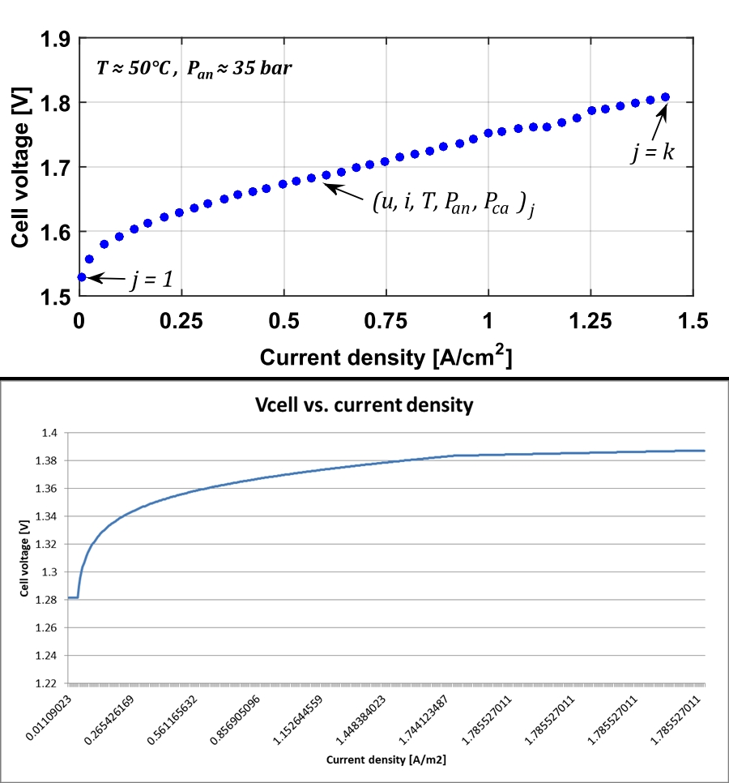
Initial Results - Electrolyser

Slide 15
Future Plans
Finalize PV farm.fmu and P2H.fmu models
Combine models in Energysim and create CEMS
Create input datasets for demand
Add more losses and ambient temperature connector “heatport”
Improve resolution of weather data

Slide 16
References
[1] P. Schott, J. Sedlmeir, N. Strobel, T. Weber, G. Fridgen, and E. Abele, “A generic data model for describing flexibility in power markets,” Energies, vol. 12, no. 10, pp. 1–29, 2019.
[2] P. D. Lund, J. Lindgren, J. Mikkola, and J. Salpakari, “Review of energy system flexibility measures to enable high levels of variable renewable electricity,” Renew. Sustain. Energy Rev., vol. 45, pp. 785–807, 2015.
[3] Gusain, D, Cvetković, M & Palensky, P 2019, Energy flexibility analysis using FMUWorld. in 2019 IEEE Milan PowerTech., 8810433, IEEE, 2019 IEEE Milan PowerTech, PowerTech 2019, Milan, Italy, 23/06/19. https://doi.org/10.1109/PTC.2019.8810433
[4] P. Dubucq and G. Ackermann, “Frequency control in coupled energy systems with high penetration of renewable energies,” 5th Int. Conf. Clean Electr. Power Renew. Energy Resour. Impact, ICCEP 2015, pp. 326–332, 2015.
[5] C. Bode and G. Schmitz, “Dynamic simulation and comparison of different configurations for a coupled energy system with 100% renewables,” Energy Procedia, vol. 155, pp. 412–430, 2018.

Slide 17
Multi Energy Systems (MES) Investigating Hidden Flexibilities Provided by Power-to-X Converters Considering Grid Support Strategies
MSc: Bekir Caner Yagci (4857089)
PhD: Digvijay Gusain
Supervisor: Asst. Prof. Milos Cvetkovic
E-mail: B.C.Yagci@student.tudelft.nl
Version Control: https://github.com/caneryagci/Multi-Energy-Systems-Thesis-Project.git

